Slide 1
LS Power
Presentation to Energy Policy
Roundtable in the PJM Footprint–
Future of Competitive Transmission
Sharon K. Segner, Vice President
December 2016

Slide 2
LS Power
LS Power is a power generation and transmission group
Power Generation
Transmission
Acquisition
Over 470 miles of 345-500kV development, construction or operations experience
Rate regulated transmission utility in the State of Texas
Active development of high-voltage transmission in USA
Over 32,000 MW of development, construction, or operations experience
Active development of renewable and fossil generation resources
Over $6 billion in private equity capital dedicated to energy sector
Acquired over 20,000 MW of power generation
Functional Expertise
Project Development
Transmission
Licensing & Environmental
Project Finance & Execution
Regulatory, Legal & Compliance
Power Marketing & Energy Management
Engineering & Construction
Operations Management

Slide 3
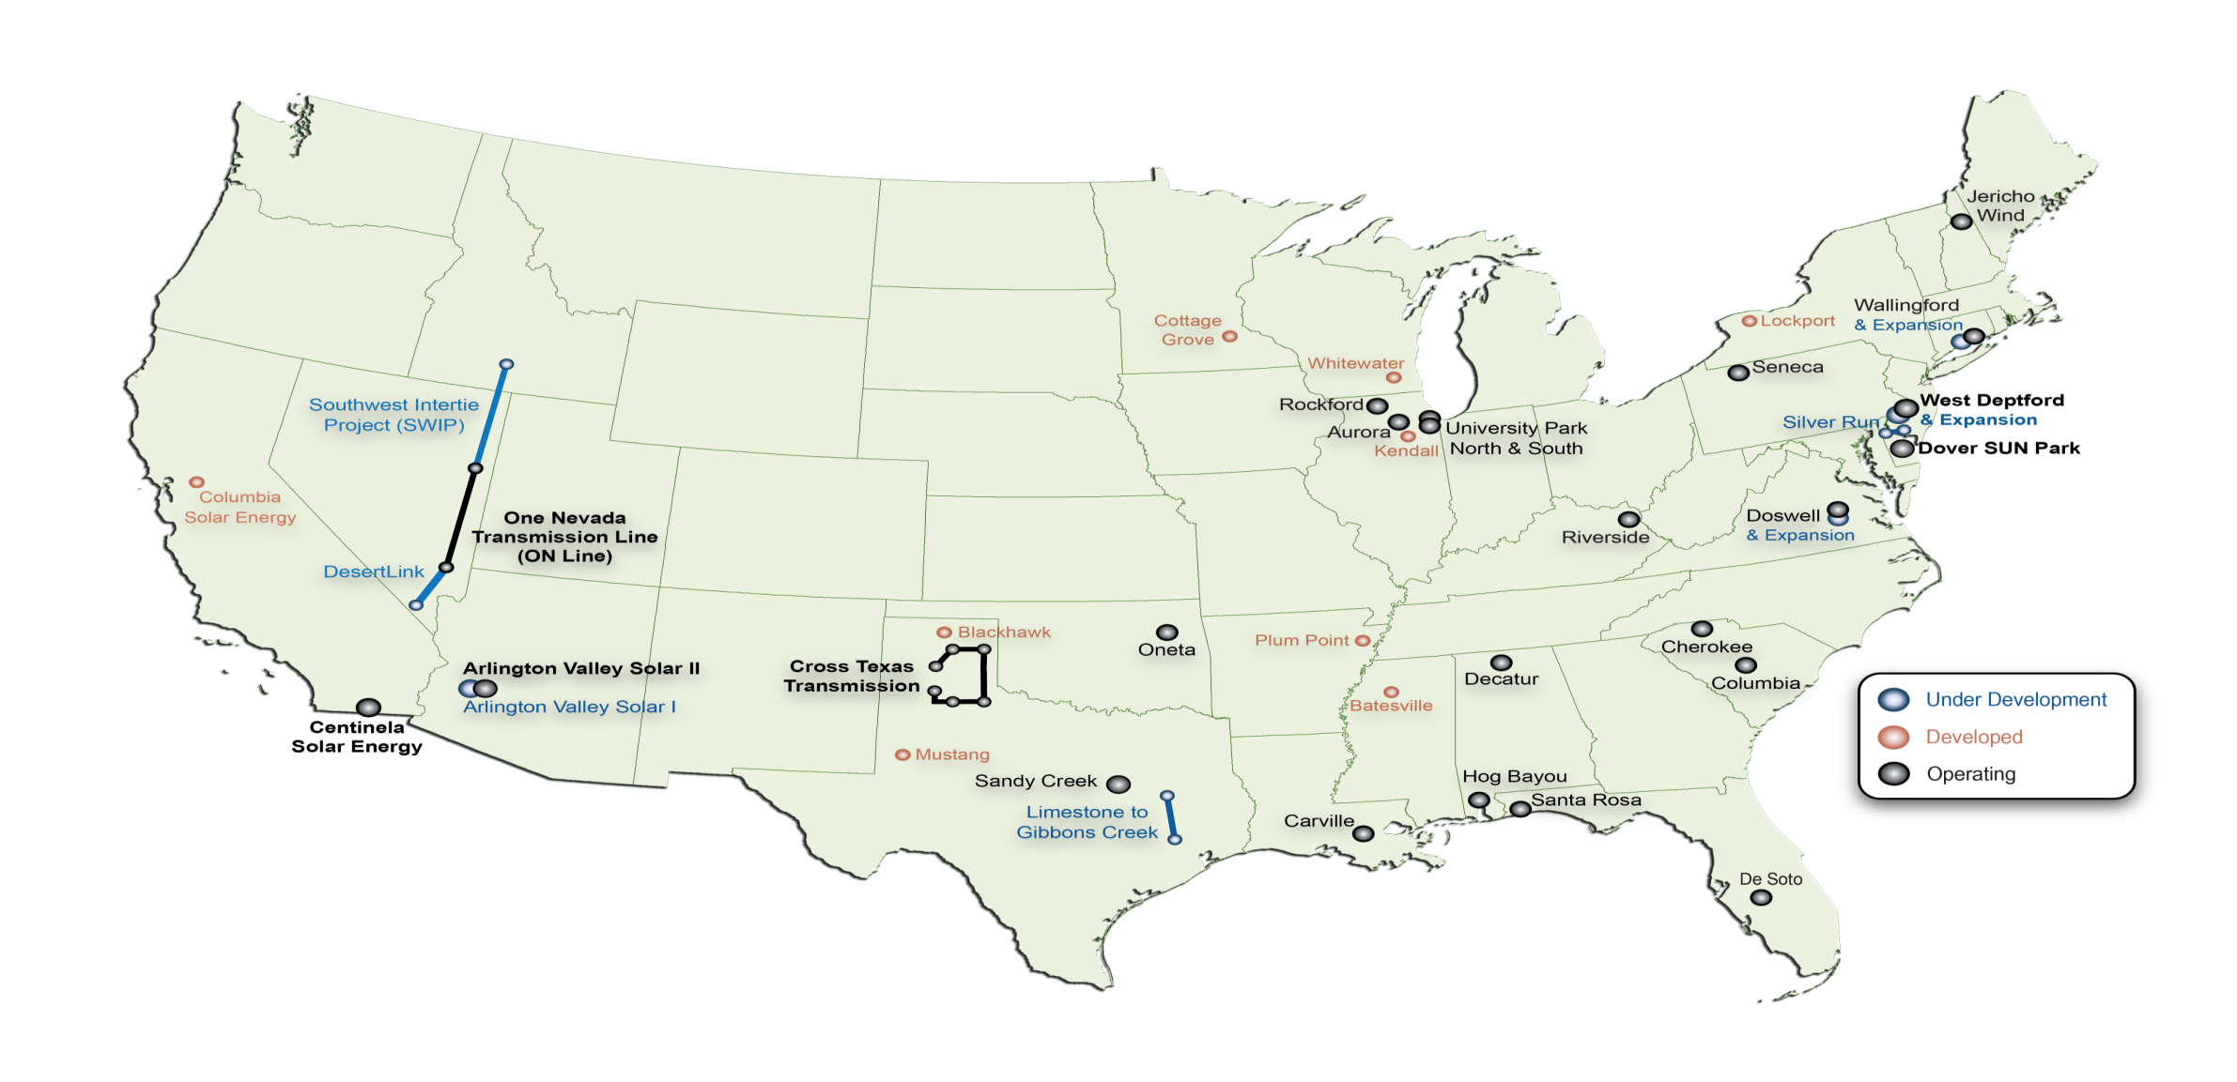
Project Portfolio

Slide 4
How is Order No. 1000 going?
It is too early for broad policy proclamations
Order No. 1000 is here to stay in PJM
DC Circuit has upheld the policy of Order No. 1000 and dismissed PJM Transmission Owner’s Mobile-Sierra case

Slide 5
What have New Entrants Learned ?
Along with CAISO, PJM is a national leader in implementing Order No. 1000
New entrants can compete in a Order No. 1000 world in PJM
New entrants have won projects in PJM
RTO independence is key

Slide 6
Competition Has Bought Cost Cap Bids
Project | Region | Cost Estimate | Cost Cap | Savings, %
Suncrest Functional Specification Project | CAISO | $50 to $75 million | $42.2 million | 15-43% lower than estimate
Estrella Project | CAISO | $35 to $45 million | $24.5 million | 30-45% lower than estimate
Delaney to Colorado River Project | CAISO | $337 million | $241 million | 28% lower than estimate
Harry Allen to Eldorado Project | CAISO | $159 million (2020 $) | $147 million | 8% lower than estimate
Add cost savings slide.
LS Power’s Binding Cost Cap on its Portion of AI Project has
Not Changed. The Cost Cap on its Portion of AI Project is $60
Million below the Original PJM Estimate.

Slide 7
What Issues are New Entrants Most Concerned about in PJM?
Cost Containment Evaluation Process
Market Efficiency Project Selection Process when several projects pass the Market Efficiency Test
Supplemental Projects
Upgrades

Slide 8
Good ratepayer policy mandates good cost containment policy
Cost containment proposals have the potential to lower costs, and therefore rates. Therefore, cost containment proposals should be encouraged.
It is too early to standardize, but general guidance from FERC could be helpful

Slide 9
FERC Should Issue A Policy Statement
LS Power’s proposal ensures the validity of Cost Containment Proposals by requiring that they meet a Three-Pronged Legal Standard Test of Distinction, Clarity, and Enforcement before they are classified as a Cost Containment Proposal.
If a proposal does not meet ALL three tests, the proposal should be considered like any other cost estimate.

Slide 10
Under our Proposed Policy Statement, there are Five Results of Being Designated as a Cost Containment Proposal
Cost Containment Proposals Would Be Made Transparent to the Stakeholders & Posted
PJM would outline in their selection process how it compared the proposals meeting the “cost containment” standard against each other
Cost Containment Proposals would have a Rebuttable Presumption in Selection Process
PJM would outline how it weighted the “cost containment” proposal in the overall selection process
Cost Containment Proposals would Be Fully Binding in Rate Cases and in the PJM Designated Entity Agreement

Slide 11
Issues of Greatest Concern
Cost Containment Evaluation Process
Market Efficiency Project Selection Process when several projects pass the Market Efficiency Test
Supplemental Projects
Upgrades

